Slide 1
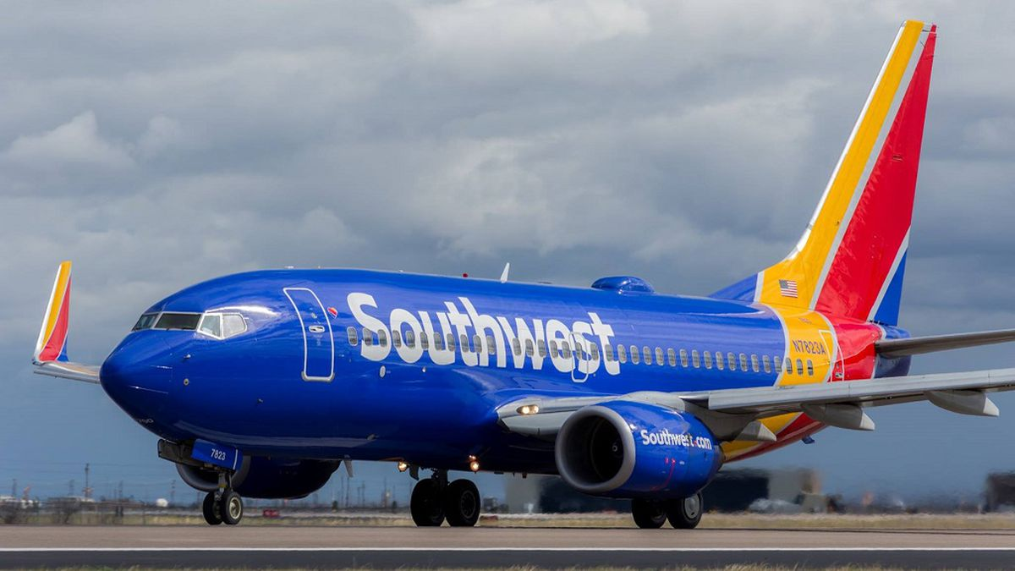

Southwest Airline Safety
College: Bellevue University
Course: DSC640-T302 Data Presentation and Visualization
6.3 Project Task 5: Video Presentation
Instructor: Professor Williams
Report by: Jake Meyer
Date: 03/01/2023
Notes:
Welcome to today’s presentation. My name is Jake Meyer and I’m a Data Analyst for Southwest Airlines.

Slide 2

Overview
Problem Description
Media has recently been reporting that air is no longer a safe way to travel.
Media is using recent airline crashes and deceitful trends of airline safety to create an unsafe image of air travel to the public.
Purpose
Present the true facts to the public on airline safety and how Southwest views the topic.
Discussion Focus
How does air travel compare to other modes of transportation for fatalities?
How have accidents via air trended over time?
How does Southwest compare to other airlines in terms of accidents and fatalities?
Notes:
The media has recently presented findings that airline travel is an unsafe mode of transportation. On behalf of our organization at Southwest Airlines, we took a deeper look into the true facts about airline safety. Let’s take a closer look into the matter from a few different perspectives:
A comparison to how airline travel compares to other modes of transportation such as (Highway, Water, Railroad).
A review of how airline accident trends have trended over time.
A look at how Southwest compares to other airlines in terms of accidents and fatalities.

Slide 3

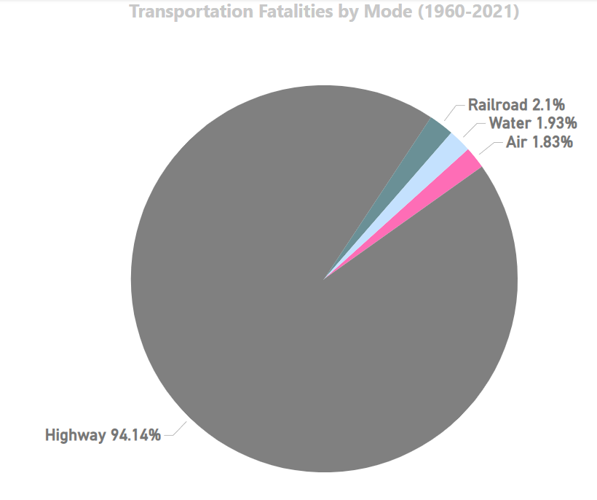
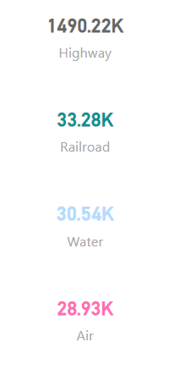
Transportation Fatalities by Mode
Fatality Count
According to the Bureau of Transportation Statistics, AIR TRAVEL had the LEAST NUMBER OF FATALITIES (between 1960-2021) compared to Highway, Railroad, and Water Travel.
Notes:
From 1960-1961, travel via Highway has resulted in the most fatalities by a landslide. In fact, Air travel has only accounted for 1.83% of fatalities overall during this timeframe.

Slide 4

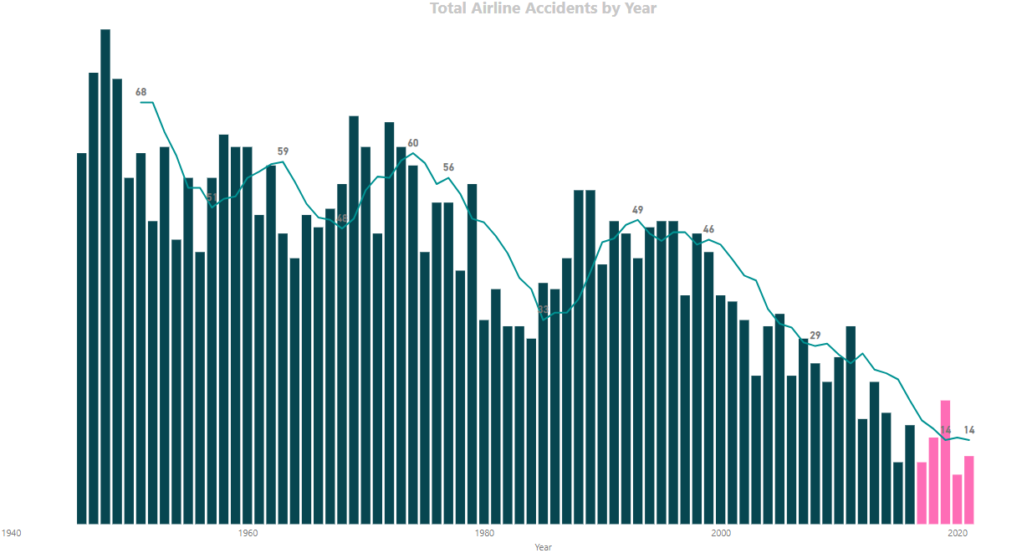
Airline Accident Trend
Air travel accidents have been trending downward over time. The Aviation Safety Network provides evidence the annual accidents due to air travel is at an all-time low since 1946.
Notes:
The rolling average for the number of accidents was as high as 68 accidents per year prior to 1960. In 2021, that number has since decreased to an all time low of 14 accidents per year on average. You can see the number of accidents per year has trended downward significantly over time.

Slide 5

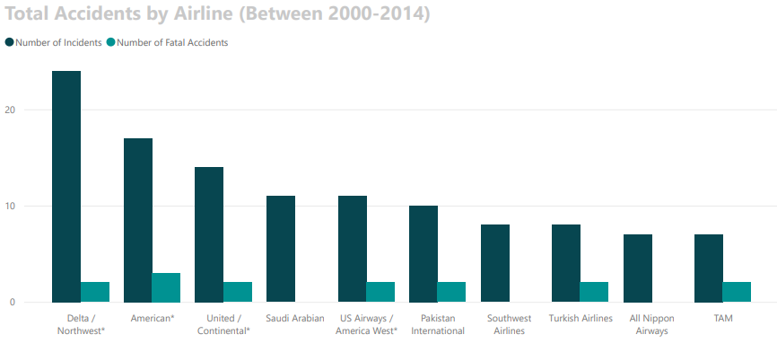
Airlines with Most Accidents
From 2000-2014, Southwest has one of the highest incident counts compared to other airlines.
No fatal incidents were reported during this timeframe.
Southwest is currently working to improve on this metric of annual incidents.
Notes:
During 2000-2014, Southwest did have one of the highest incident counts when compared to other airlines. However, these were minor accidents that resulted in no fatalities. Southwest has committed to improving on this metric and remains committed to safety as a number one priority both for its employees and passengers.

Slide 6

Final Statement
Southwest remains a safe option for travel and can be trusted to get you and your loved ones to the next destination.
Notes:
Through safety process risk mitigation reviews, improved safety technology, and a committed workforce within Southwest, we strive to make safety a number one focus for the organization. The true facts for airline travel provide evidence against the medias false accusations about safety within the airline industry. Southwest remains a safe option for travel and can be trusted to get you and your loved ones to the next destination.

Slide 7
Data Sources
Bureau of Aircraft Accidents Archives. (2023). Accidents Rate Per Year. Statistics. Accidents Rate per Year | Bureau of Aircraft Accidents Archives (baaa-acro.com)
Bureau of Transportation Statistics. (2023). Transportation Fatalities by Mode. United States Department of Transportation. Transportation Fatalities by Mode | Bureau of Transportation Statistics (bts.gov)
David, Isaiah. (2023). Advantages of Air Travel. USA Today. Advantages of Air Travel (usatoday.com)
Escobar, Francisco. (2019). The Statistics of Airplane Accidents [Data]. Kaggle. The Statistics of Airplane Accidents | Kaggle
Fivethirtyeight. (2023). Airline Safety [Data]. Github. data/airline-safety at master · fivethirtyeight/data · GitHub
McMahon, Conor. (2022). 20 Southwest Airlines Statistics [2023]: Passengers, Revenue, and Facts. Zippia. 20 Southwest Airlines Statistics [2023]: Passengers, Revenue, And Facts – Zippia
Nussbaumer, Cole (2015). Storytelling with Data. John Wiley & Sons, Inc.
Ranter, Harro. (2021). Aviation Safety Network [Data]. Aviation Safety Network Database. Accidents and fatalities per year - Google Sheets
Yau, Nathan. (2011). Visualize This. (1st ed). John Wiley & Sons, Inc.
WLBT Digital (2020). Soutwest Airlines returning to Jackson airport in 2021. [Photo]. Southwest Airlines returning to Jackson airport in 2021 (wtok.com)

